Slide 1
Power analysis of female murder victims’ relationship with offenders
Amy Schneider and Alonna Guerrero
Notes:
Speaker:

Slide 2
Importance and implications
Law enforcement agencies and the FBI catalog data on crimes, but this data is limited to both proper reporting documentation by the agency as well as available information on the circumstances of the crime.
As a limitation of the available data, a power analysis can provide information on whether or not the data available can be used to draw meaningful correlations.
Murder is the most egregious crime and better understanding the nature of its crimes can help provide direction in crime prevention and intervention.
Notes:
Our data set comes from crime information provided by law enforcement agencies
This data is cataloged by the FBI, but is limited in both proper reporting documentation by the agency as well as available information on the circumstances of the crime.
As a limitation of the available data, a power analysis can provide information on whether or not the data available can be used to draw meaningful correlations.
Murder is the most heinous crime in our society and better understanding the patterns in murders can help aid in crime prevention and intervention.

Slide 3
The most dangerous place in the world for a woman is inside her own home.
United Nations Office on Drugs and Crime, 2017
Notes:
https://www.unodc.org/unodc/en/press/releases/2018/November/home--the-most-dangerous-place-for-women--with-majority-of-female-homicide-victims-worldwide-killed-by-partners-or-family--unodc-study-says.html
If the most dangerous place for a woman is inside of her own home, how did a global shutdown and stay at home order influence violent crime against women?

Slide 4
dataset
National Incident-Based Reporting System (NIBRS)
About The NIBRS:
Part of the Uniform Crime Reporting Program (UCR)
Administered by the Federal Bureau of Investigation (FBI)
Annually compiled dataset focusing on arrests, crime, crime rates, crime reporting, law enforcement agencies, national crime statistics (USA), offenders, offenses, property crimes, Uniform Crime Reports, victims, and violent crime in United States
2020 Victim Extract Files (0004):
Simplifies the NIBRS providing only data relating to the victim of a documented crime in 2020
Notes:
National Incident-Based Reporting System, 2020: Extract Files (ICPSR 38566)
The National Incident-Based Reporting System (NIBRS) is a part of the Uniform Crime Reporting Program (UCR), administered by the Federal Bureau of Investigation (FBI).
NIBRS is an annual data collection that compiles information on criminal incidents and arrests reported by participating law enforcement agencies. NIBRS data is formatted by the FBI are stored as a series of single files organized by various segment levels (record types).
In order to investigate the relationship between murder victims and their offender, we specifically focused on the Victim extract from 2020.
There are six main segment levels: administrative, offense, property, victim, offender, and arrestee. Each segment level has a different length and layout. Significant computing resources are necessary to work with the data in its single-file format. In addition, the user must be knowledgeable about working with data in complex file types. The extract files version of the NIBRS files was created to simplify working with NIBRS data. Data management issues with NIBRS are significant, especially when two or more segment levels are being merged. For these reasons and the desire to facilitate the use of NIBRS data, ICPSR created the extract files. The data are not a nationally representative sample of crime in the United States.
Funding: United States Department of Justice. Office of Justice Programs. Bureau of Justice Statistics
Subject Terms: arrests, crime, crime rates, crime reporting, law enforcement agencies, national crime statistics (USA), offenders, offenses, property crimes, Uniform Crime Reports, victims, violent crime
Geographic Coverage: United States
Smallest Geographic Unit: city
Distributor(s): Inter-university Consortium for Political and Social Research
Citation (for works cited)
United States. Bureau of Justice Statistics. National Incident-Based Reporting System, 2020: Extract Files. Inter-university Consortium for Political and Social Research [distributor], 2022-11-22. https://doi.org/10.3886/ICPSR38566.v2

Slide 5
Data preparation
Filtered Down To Columns Of Interest
Type Of Crime
Sex Of Victim
Relationship To Offender
Included only Murder/Nonnegligent Manslaughter
Added In Grouping Column To Categorize Relationship To Offender
Intimate Partner
Family Member
Friend / Otherwise Known
Stranger
Unknown
Created two subsets of data
Female Murder Victims
Male Murder Victims
Notes:
Data Preparation: data cleaning and munging, removal of outliers, data transformation, feature extraction, feature selection, etc.
Filtering the expansive data collection down to look only at columns of interest:
Of the 294 available columns, we only needed those relating to:
Relationship To Offender, Sex Of Victim, Type Of Crime
Relationship To Offender: included all available categories and created a grouping by the relationship type, and called this new column relationship grouping
Type Of Crime:
7 total columns that relate to 720 possible type of crime labels
Only one Type Of Crime column included (091) Murder/Nonnegligent Manslaughter
Sex Of Victim: create two subsets of the data to isolate patterns based off of the sex of the victim
Added In Grouping Column To Categorize Relationship To Offender
Utilized a mutate and case_when statement in R to:
Add in an additional column to our data entitled "relationship_grouping"
Created four groups to Summarize the 25 possible Relationship To Offender labels (Intimate Partner, Family Member, Friend / Otherwise Known, Stranger, Unknown)
Intimate Partner ((01) Victim was Spouse , (02) Victim was Common-Law Spouse, (18) Victim was Boyfriend/Girlfriend, (20) Homosexual Relationship, (21) Victim was Ex-Spouse, (26) Victim was Ex-Relationship (Ex-boyfriend/ex-girlfriend))
Family Member ((03) Victim was Parent, (05) Victim was Child, (19) Victim was Child of Boyfriend/Girlfriend, (04) Victim was Sibling, (12) Victim was Other Family Member, (08) Victim was In-Law, (06) Victim was Grandparent, (09) Victim was Stepparent, (10) Victim was Stepchild, (07) Victim was Grandchild)
Friend / Otherwise Known ((24) Victim was Otherwise Known, (14) Victim was Acquaintance, (16) Victim was Neighbor, (15) Victim was Friend), (17) Victim was Babysittee (the baby))
Stranger ((25) Victim was Stranger
Unknown ((00) N offenders unknown)/N/A

Slide 6

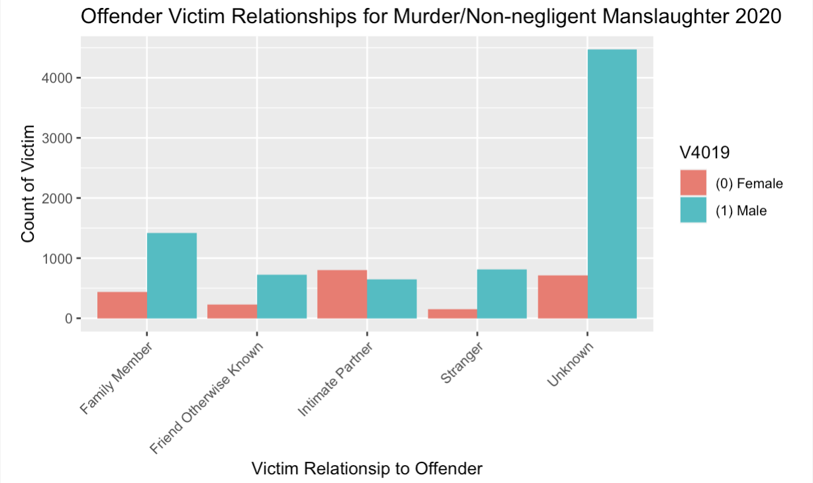

Data Visualization Relationship Grouping summary
Notes:
The first visualization we used to examine the relationship grouping data further was a bar plot. This allowed us to better understand the ratios of each relationship grouping by gender as well as the gender ratios for a victim-offender relationship side by side.
As you can see, the unknown assailants for the males eclipse the rest of the data.

Slide 7
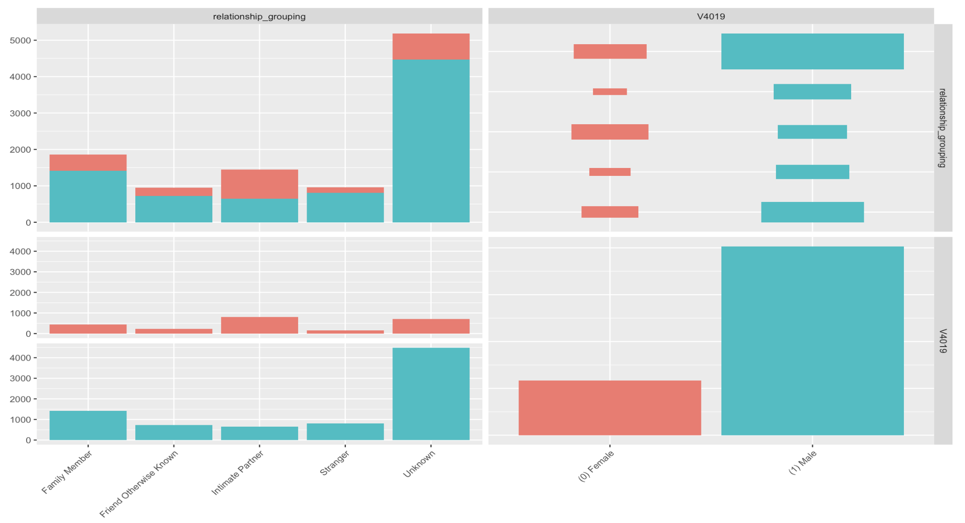
Data Visualization GGPAIRS PLOT
Notes:
To explore this data more, we used a ggpairs plot, which creates a pairwise comparison between each column and displays the density of each.

Slide 8
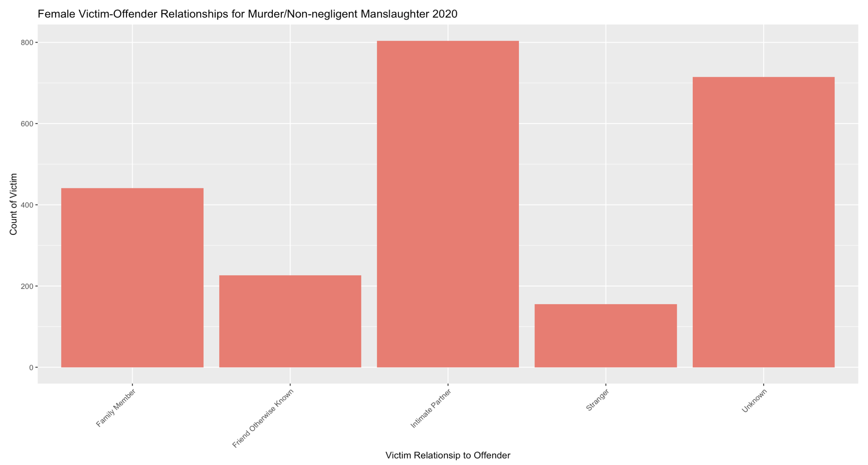

Data Visualization Female murder/non-negligent death victims
Notes:
Next, we looked at the female data by relationship grouping.
This allowed us to make a few observations, such as the fact that the intimate partner is the highest proportion of the data, followed by the unknown group, while stranger is the smallest proportion.

Slide 9
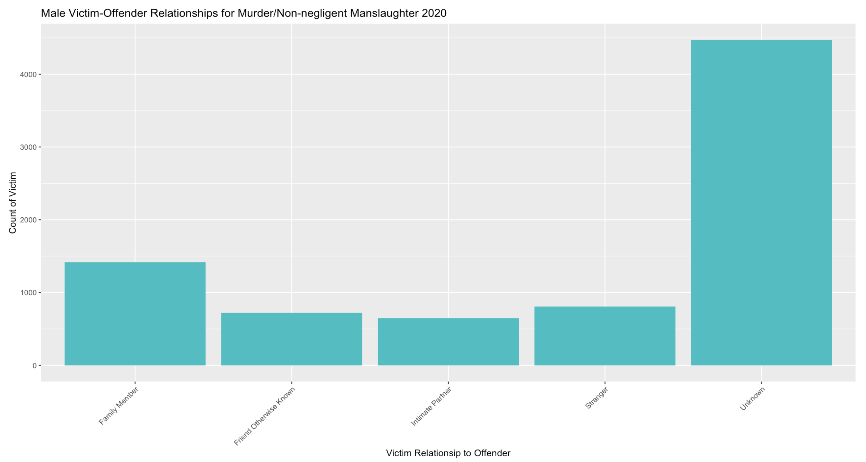
Data Visualization male murder/non-negligent death victims
Notes:
Finally, we looked at the male data by relationship grouping, and the fact that intimate partner was the smallest proportion of the data was not lost on us.

Slide 10
Model description
Two Main Questions:
Is there a statistically significant difference between men and women when looking at the proportion at which they were in an intimate relationship with the offender?
Proportional Analysis
How confident are we that the results from this proportional analysis is genuine and significant (meaning, it is not due to chance)?
Power Analysis of binary data sets (searching for power rating)
Power Analysis of binary data sets (searching for smallest sample to maintain high power rating)
Notes:
Speaker: Amy
How confident are we that the results from this proportional analysis is genuine and significant (meaning, it is not due to chance)?
Power Analysis: It helps to determine if a result from an experiment or survey is due to chance, or if it is genuine and significant.
First, we found the proportion of female and male murder victims who had an intimate partner relationships and ensured that these proportions were significantly different
Next, we ran a power analysis on both the male & female victim data sets
The results from our initial power analysis led us to run additional analyses to determine the smallest sample size needed for each population to maintain a high power rating.

Slide 11
Model description
What Is A Power Analysis?
Determines how likely researches are to commit a type II error
Power: probability between 0 and 1 that an effect that is present is detected.
The closer a power rating is to 1, the more confident you can be that the effect you are detecting is genuine and not due to chance.
For example, with power = 0.80, if there are genuine effects to be found in 10 different studies, they will only be found in 8 of the studies.
Typically, it understood that a power score of 0.80 is a "good" power level.
Effect size: proportion of effect
in your data between 0 and 1. For our data, we utilized the calculated significantly different proportions from our proportion test.
Sample size: number of people in a sample population.
Alpha: significance level
typically set 0.05.
Notes:
Speaker: Amy
A power analysis is a statistical test that can be conducted before or after a study takes place.
Performing a power analysis in advance of a study allows researchers to understand what sample size is necessary in order to gain meaningful statistically significant data, for example, during a randomized controlled trial.
A post hoc analysis is conducted after the fact to understand how much power is in the data to detect any statistically significant differences. Retrospective analyses are not as common, however they help in understanding if there is a high potential of a type II error due to sample size.
A type II error is the failure to reject a null hypothesis that is actually false. Our analysis is a retrospective analysis due to the nature of the data collection and timing of our work. The null hypothesis in our case, for females, is that there is no difference in the proportion of victim-offender relationships for intimate partners relative to other relationship groupings.
Power, effect size, sample size and alpha are connected to the extent that each is a function of the other three. Since we knew the effect size, sample size, and alpha score of our female data set, we were able to calculate the overall power.

Slide 12
Analysis
Proportional Analysis
2-sample test for equality of proportions with continuity correction
p-value < 2.2e-16
significant difference in proportion between women who were killed by intimate partners in 2020 when compared to men
Power Analysis
proportion power calculation for binomial distribution (arcsine transformation)
Female Victim Data Set: Power = 1
Male Victim Data Set: Power = 0.9999
finding smallest sample size needed to still correctly reject our null hypothesis while maintaining a high power (0.8)
Female Victim Data Set: Smallest Sample = ~67 female murder/non-negligent death victims (~23 of which with intimate partner relationship)
Male Victim Data Set: ~1223 male murder/non-negligent death victims (~97 of which with intimate partner relationship)
Comparing Yielded Power With An Equal Sample Size
Notes:
Speaker: Amy

Slide 13
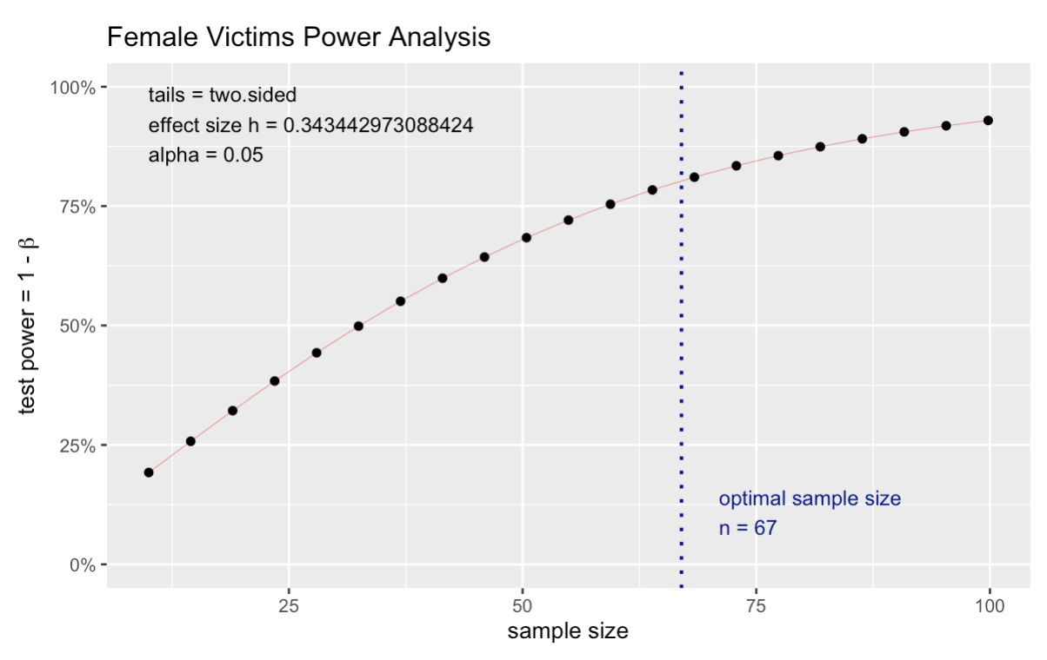
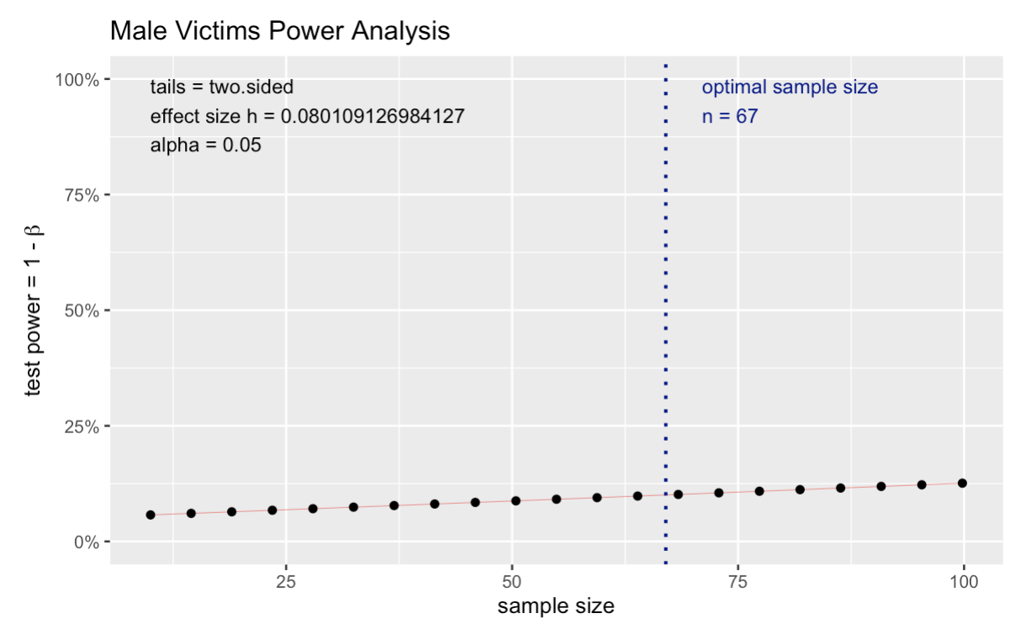
Analysis
Notes:
Speaker: Amy
Once again, when looking at a sample of 67 female murder victims we can confidently predict, with a power rating of 0.8, that 23 of these women died at the hands of an intimate partner. When we look at the same sample size of 67 male murder victims, we would yield a power rating of 0.1. Meaning, we could not confidently predict how many of these men were killed by an intimate partner. The impact of these results is staggering. Women are so disproportionately killed at the hand of an intimate partner when compared to men, that the number of victims needed to prove the effect for women with statistical confidence would not even yield a usable prediction for men.

Slide 14
Model evaluation
Limitations
Male versus female power analysis
Data Set Limitations
High rate of unknown victim-offender relationship grouping
Missing state data
Possible Enhancements
missing data
offender details
victim diversity statistics
Notes:
Speaker: Amy
We were not able to confidently run a power analysis that included both male and female victim proportions and both sample sizes with meaningful results. Due to the large sample size disparity between our male and female victim data sets, and the significant effect size differences, one always overpowered the other. For example, if we were to run a power analysis looking at our male and female intimate partner relationship proportions in the total murder/non-negligent death population, the effect size for female victims overwhelmed the male victim effect size and still yielded a high power. When we break this calculation down into the male and female victim data set analysis we can clearly see there significant difference between the 0.8 power for female victims and the 0.1 power for male victims.
Further limitations from our model are rooted in the limitations stemming from the NIBRS data set itself. The first data set limitation is in regards to the high count of unknown victim-offender relationships. Our initial worry was that the large number of unknown victim-offender relationships would incorrectly skew our data. For example, if all of those cases were solved tomorrow and the correct relationship groupings were assigned, would the effect sizes we found still be present? This is exactly what our initial power analysis proved. The results that we found in both the male and female victim data sets were without a doubt genuine effects in the data, and we can confidently state this with 99.99% and 100% certainty respectively. Therefore, even if all of the unknown cases were solved tomorrow, our effect sizes would still be statistically significant.
An additional limitation from the NIBRS data set, is that the NIBRS was not officially rolled out until 2021, therefore, our 2020 data is not a comprehensive look at crime in United States. States such as California, New York, and Florida had not switched over to this new system at the time the 2020 data was collected. These states not only have high populations, but they tend to have high reported crime rates as well. If we were to add in the reported murder/non-negligent deaths from these missing states, we would need to rerun our study fully as sample sizes, intimate partner victim-offender relationship proportions, and power would all be effected.
To enhance our model, we would propose a new project to include all missing state data and a deeper analysis around offender details and victim diversity statistics. For example, do most of the intimate partner offenders have a preexisting record in their local law enforcement agency? Are women of color more at risk to be killed at the hands of an intimate partner? What about victims who do not identify on the gender binary, are they disproportionately at risk to be murder/non-negligent death victims? Further analysis can provide a deeper and more thorough conclusion of the effect sizes we calculated and relative power of these findings.

Slide 15
Conclusion
Not only has our analysis proved our initial hypothesis, that women are most likely to be killed by an intimate partner, but we additionally proved that this effect is significantly disproportionate when compared to male murder/non-negligent death victims.
2341 women were reported victims of murder or non-negligent death in 2020. 804 of these women died at the hands of an intimate partner. Yet, women are still not believed when they report intimate partner abuse. Women are not believed despite the fact that they are statistically more likely to be killed by their partner than they are by any other known and unknown relationship. If our analysis provides nothing more than a warning for women currently experiencing intimate partner abuse, it will have been well worth it. Seek help, find support.
Notes:
Speaker: Amy

